Slide 1

Amazon Sales Performance Analysis
Nishtha Patel
College of Professional Studies, Northeastern University ALY6070 (CRN 20507): Communication and Visualization for Data Analytics Professor: Dr. Paromita Guha March 24th, 2025

Slide 2
Problem Statement
How can we optimize product offerings, regional strategies, and logistics operations to improve overall sales performance and customer satisfaction on Amazon?

Slide 3
Target Audience
This dashboard is designed to provide valuable weekly sales insights to stakeholders involved in category management, planning, and marketing strategy.
Category Managers→ To track sales performance trends and identify top- or under-performing product lines over time.
Marketing Teams→ To align promotional campaigns with peaks and dips in category demand.
Inventory & Demand Planners→ To forecast demand accurately and ensure optimal stock levels based on category trends.

Slide 4
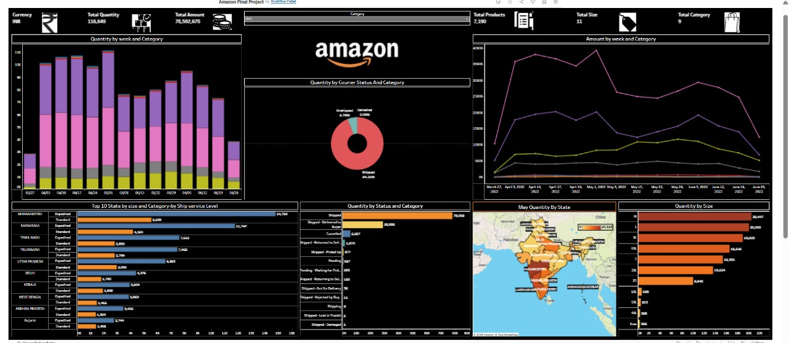
Amazon Sales Analysis Dashboard

Slide 5
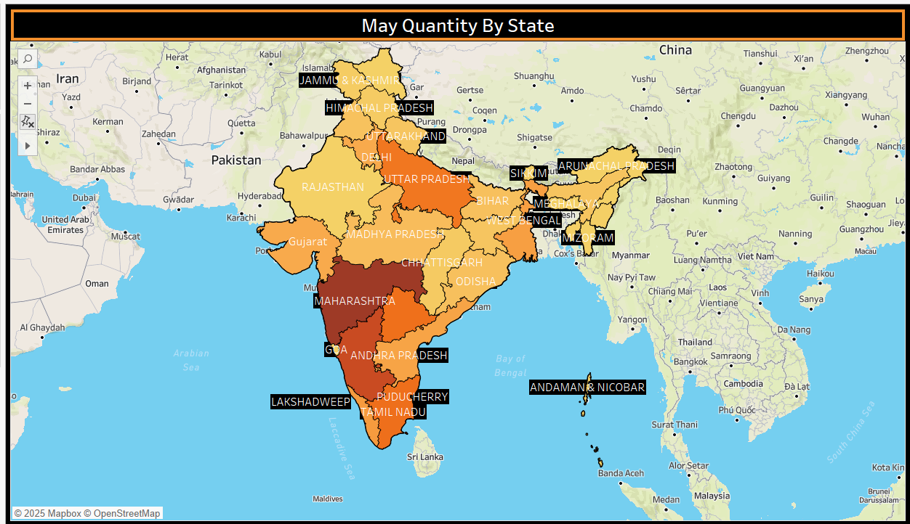
Where are most of the sales occurring?
The varying shades of yellow-orange on the map visually represent shipment quantities across states—darker shades indicate higher sales, while lighter shades indicate lower sales, helping us instantly identify high-performing regions like Maharashtra at a glance.

Slide 6
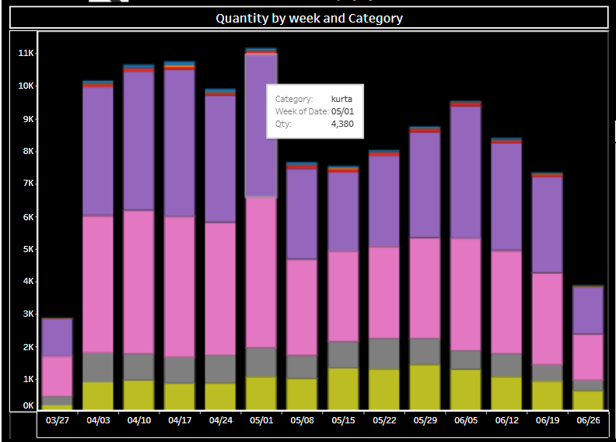
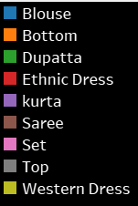
2. How do sales quantities fluctuate over time?
Sales quantities peaked during the week of 1 May 2022, driven largely by high demand in categories like Kurta, Blouse, Bottom, Western Wear, and many other.
The Stacked Bar Chart format with distinct category colors makes it easy to compare contributions of each product type week over week.

Slide 7
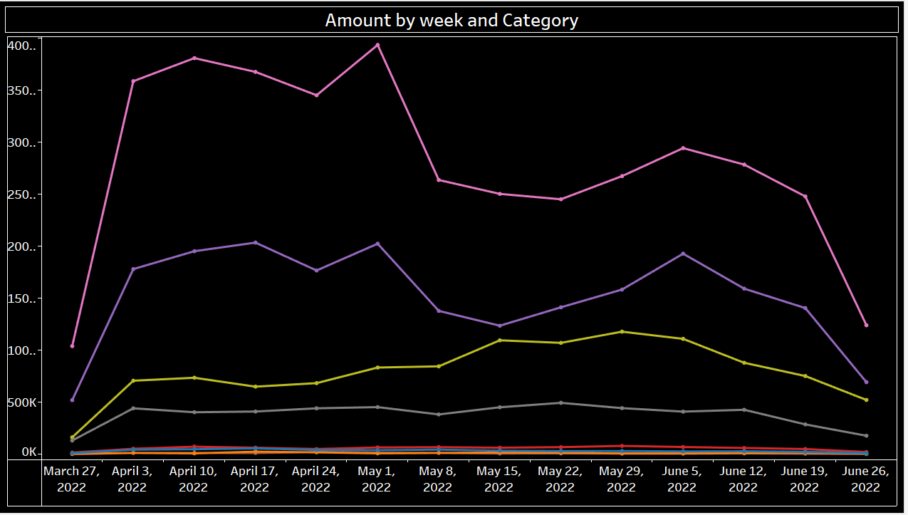
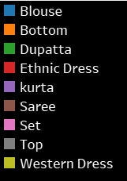
How does revenue change over time, and which categories contribute the most?
Sales quantities peaked during the week of 1 May 2022, driven largely by high demand in categories like Kurta and Bottom Wear.
The Line Graph format with distinct category colors makes it easy to compare contributions of each product type week over week.

Slide 8
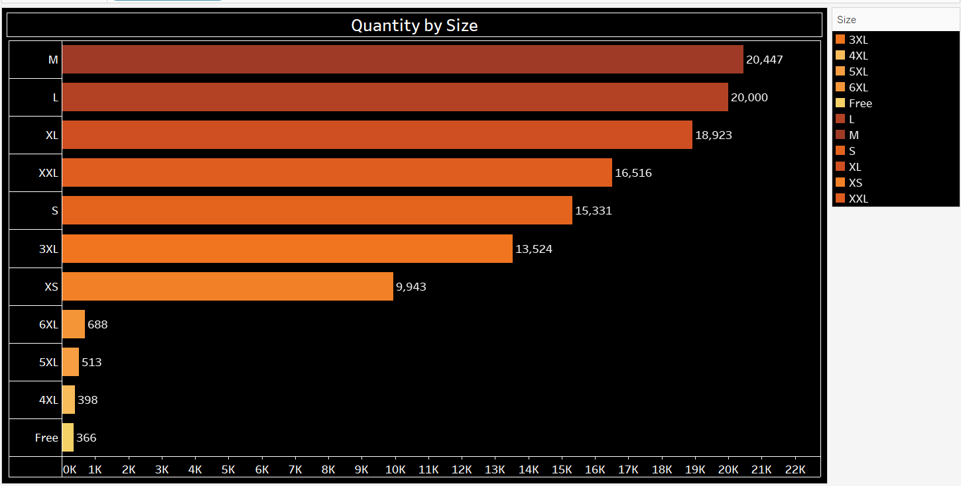
What are the most and least popular product sizes?
The M, L, XL, and XXL sizes dominate sales, with M & L being the highest-selling size at 20K units, while 4XL and Free sizes show zero demand.
The horizontal bar chart effectively ranks sizes in descending order, making it easy to compare popularity and optimize inventory planning.

Slide 9
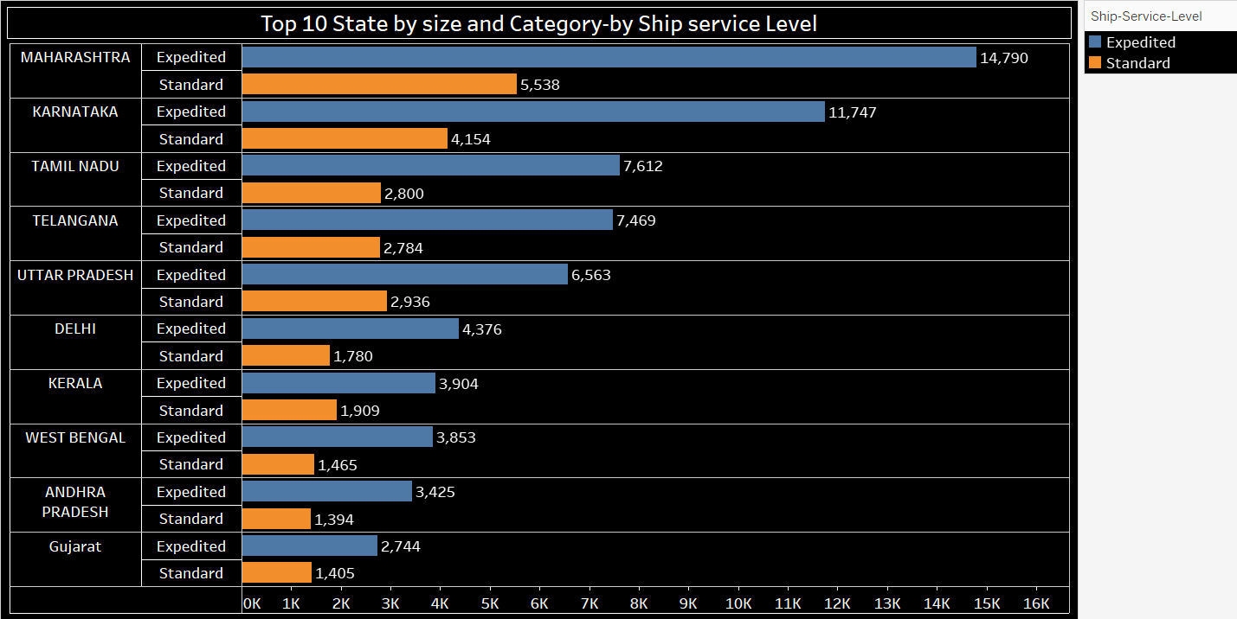
Which states contribute the most to order volume, and how does shipping preference vary?
Maharashtra, Karnataka, and Tamil Nadu have the highest order volumes, with expedited shipping being the preferred choice across all top states.
The grouped bar chart allows for an easy comparison between expedited and standard shipping within each state, highlighting where faster delivery is in higher demand.

Slide 10
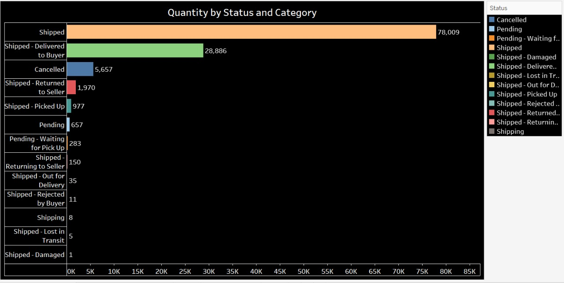
What is the breakdown of order status?
The majority of orders (78,009) have been successfully shipped, with 28,886 orders delivered to buyers, while cancellations (5,657) and returns (1,970) remain relatively low.
The horizontal bar chart clearly differentiates order statuses, making it easy to identify fulfillment success and areas for potential improvement in cancellations and returns.

Slide 11
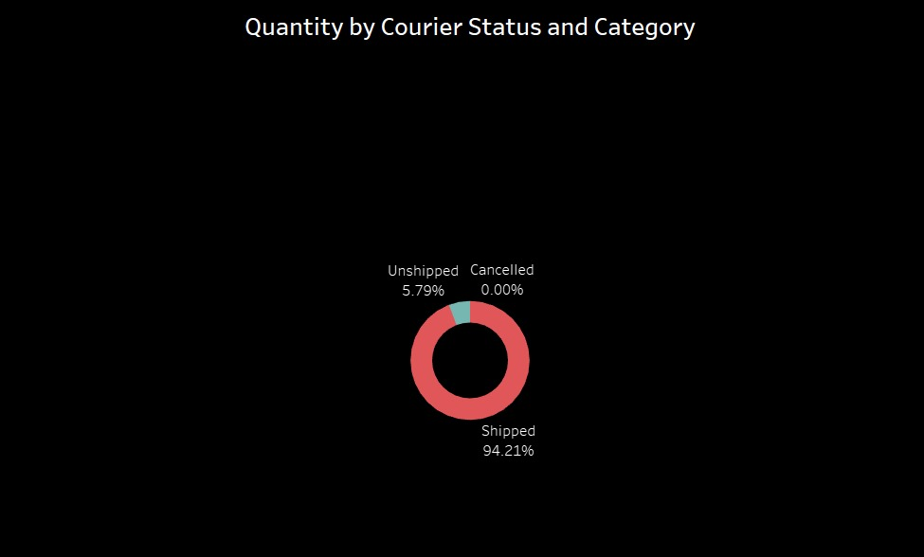
How Efficient is the Courier Fulfillment Process?
With 94.21% of orders successfully shipped and only 5.79% unshipped, the fulfillment process appears highly efficient, while cancellations are at 0%.
The donut chart provides a clear proportional breakdown of courier status, making it easy to assess overall logistics performance.

Slide 12
THANK YOU

